Slide 1

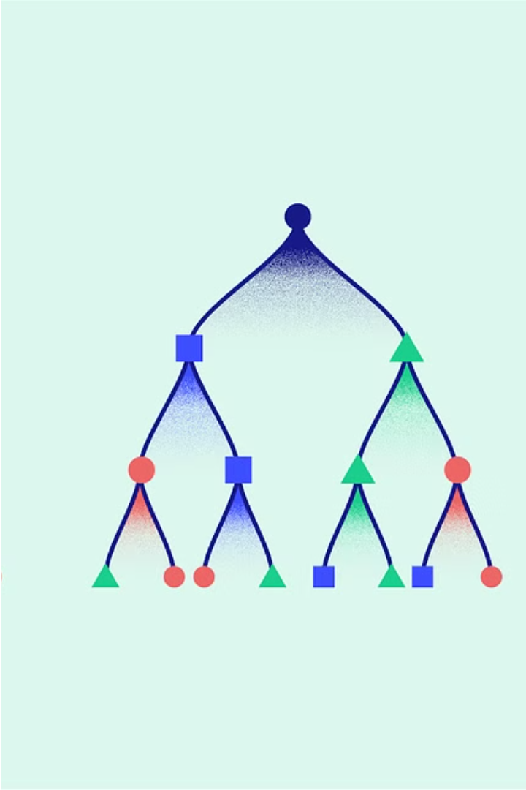

Introduction to XGBoost
XGBoost is a powerful machine learning algorithm that is widely used for its efficiency, accuracy, and scalability. It is a gradient boosting framework that uses decision trees as the base learners, making it highly effective for a wide range of supervised learning tasks.
by Praveen kumar T G

Slide 2
Key Features of XGBoost
Regularization
Parallel Processing
Handling Missing Values
XGBoost includes powerful regularization methods to prevent overfitting, such as L1 and L2 regularization, making it robust to noisy data.
XGBoost can perform parallel tree building, allowing it to scale efficiently to large datasets and complex models.
XGBoost has built-in support for handling missing values, making it a practical choice for real-world data problems.

Slide 3
Advantages of XGBoost
1
High Accuracy
2
Efficient and Scalable
XGBoost consistently outperforms many other machine learning algorithms, including random forests and logistic regression.
XGBoost is highly efficient and can handle large-scale data and complex models with ease.
3
Robust to Outliers
4
Feature Importance
The algorithm's built-in regularization methods make it less sensitive to outliers in the data.
XGBoost provides valuable insights into feature importance, helping with feature selection and model interpretability.

Slide 4
Use Cases of XGBoost
Classification
Regression
XGBoost is widely used for binary and multi-class classification tasks, such as credit card fraud detection and spam filtering.
XGBoost is also effective for regression problems, including predicting sales, stock prices, and customer churn.
Ranking
Time Series Forecasting
XGBoost can be used for ranking tasks, such as optimizing search engine results or recommending products.
XGBoost's ability to handle complex patterns makes it a strong choice for time series forecasting problems.

Slide 5
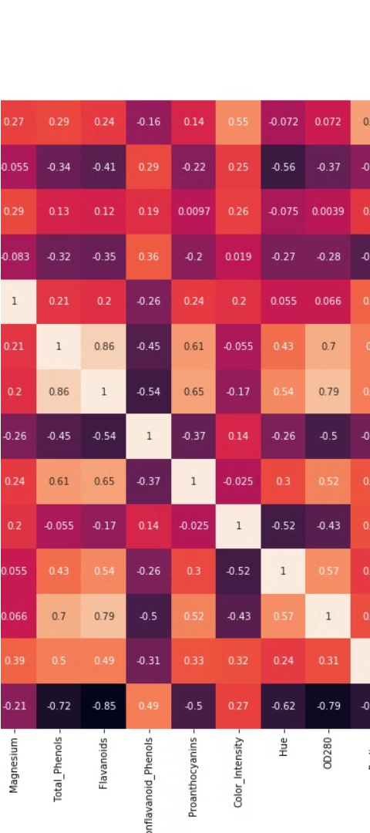
Implementing XGBoost in Python
1
Data Preparation
Load and preprocess the dataset, handling missing values and encoding categorical features.
2
Model Training
Import the XGBoost library and use the XGBClassifier or XGBRegressor to train the model, tuning hyperparameters as needed.
3
Model Evaluation
Evaluate the model's performance using metrics like accuracy, F1-score, or R-squared, and fine-tune the model if necessary.

Slide 6




Applications of XGBoost
Finance
Healthcare
Marketing
Agriculture
XGBoost is widely used in the finance industry for tasks like credit risk modeling, fraud detection, and stock market prediction.
XGBoost is applied in healthcare for disease diagnosis, patient risk prediction, and drug discovery.
XGBoost is used in marketing for customer churn prediction, targeted advertising, and recommendation systems.
XGBoost is employed in agriculture for crop yield prediction, pest and disease control, and precision farming.

Slide 7
Conclusion and Key Takeaways
XGBoost is a versatile and powerful machine learning algorithm that has gained widespread adoption across various industries. Its ability to deliver high-accuracy results, handle complex data, and provide interpretable insights makes it a go-to choice for a wide range of supervised learning problems. As you continue to explore and apply XGBoost, remember its key strengths: regularization, parallel processing, missing value handling, and feature importance.

